Slide 1
Real ESTATE PRICE PREDICTION
Dhruv - 11021210069
Shreya - 11021210078

Slide 2
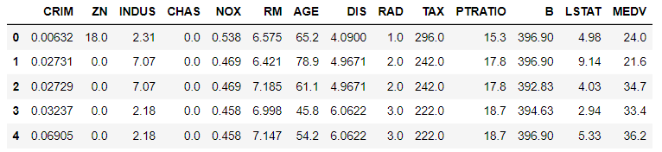
About the Dataset
The dataset used for this comparative analysis is BOSTON HOUSING DATASET.
It consists of 506 instances and 13 features.
Features include crime rate , no. of rooms , distance to employment centres , full value property tax rate etc.
The target variable is MEDV (median value of owner occupied homes).
We look through the relationship of each individual feature with MEDV using a correlation matrix . Observing which factor influences the prices most.

Slide 3
CRIM (Per Capita Crime Rate)
ZN (Proportion of Residential Land zoned for Large Lots)
INDUS (Proportion of Non-Retail Business Acres)
CHAS (Charles River Dummy Variable)
NOX (Nitric Oxides Concentration)
RM (Average Number of Rooms per Dwelling)
AGE (Proportion of Owner-Occupied Units Built Prior to 1940)
DIS (Weighted Distances to Employment Centers)
RAD (Index of Accessibility to Radial Highways)
TAX (Full-value Property Tax Rate per $10,000)
PTRATIO (Pupil-Teacher Ratio by Town)
B (1000(Bk - 0.63) ^2 where Bk is the proportion of Black Residents)
LSTAT (Percentage of Lower Status of the Population)
Target Variable:
MEDV (Median Value of Owner-Occupied Homes)

Slide 4

Data Models Used
Linear Regression
Random
Forest
Gradient Boosting
SVM
knn
RIDGE
REGRESSION
LASSO
REGRESSION

Slide 5
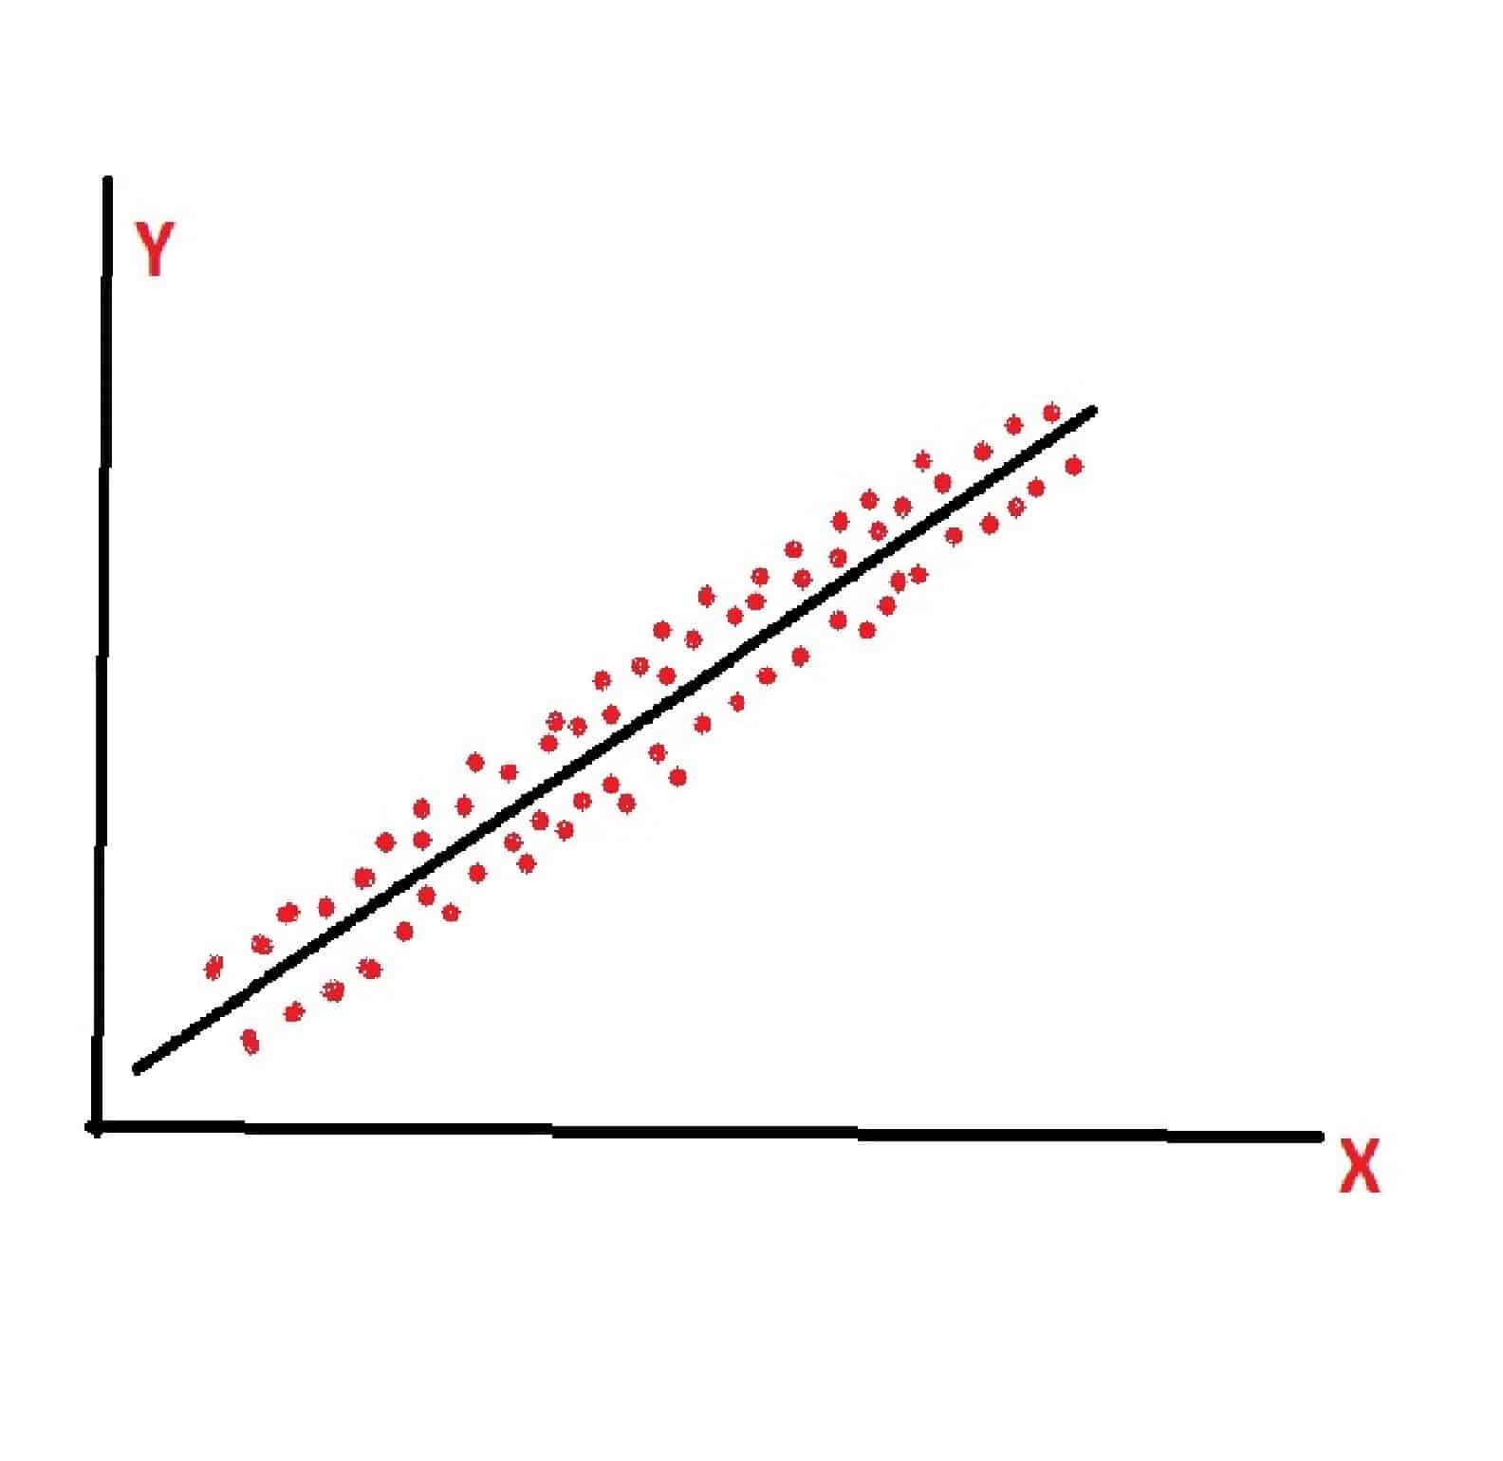
Linear Regression
Statistical method used to model the relationship
between a dependent variable and one or more independent variables by fitting a linear equation to the observed data.
Boston Housing dataset, linear regression can be applied to model the relationship between various factors (independent variables like crime rate, property tax, room distribution, etc.) and the median value of owner-occupied homes (dependent variable).
By using linear regression, one can analyze how changes in these factors are associated with changes in housing prices.

Slide 6
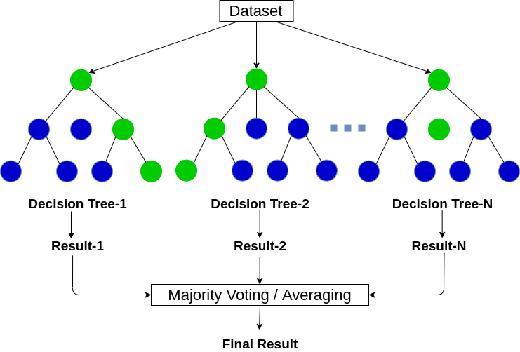
Random Forest
Random Forest is an ensemble method that combines the predictions of multiple decision trees to improve overall accuracy and robustness.
Each tree in the forest is a decision tree, which is a model that makes decisions based on a series of hierarchical if-else conditions.
Voting/Aggregating
For regression tasks, the predictions of individual trees are averaged to obtain the final prediction. This ensemble approach often leads to more accurate and stable results compared to a single decision tree.
Random Forest, being a non-linear model, can capture more complex, non-linear relationships in the data.

Slide 7
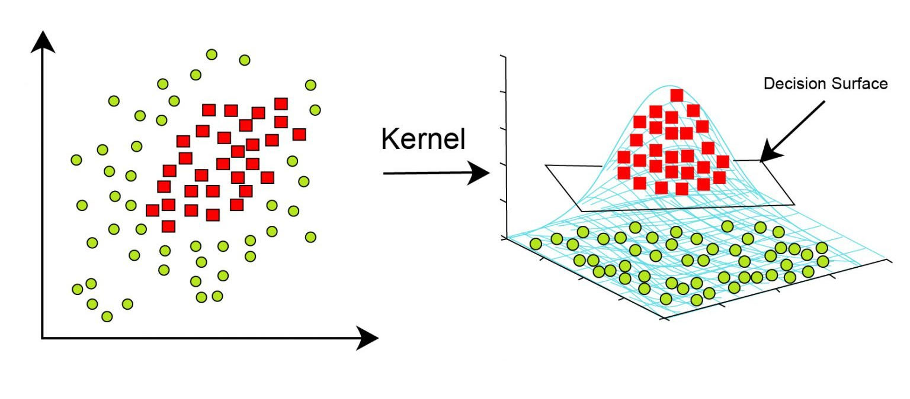
SVM
SVM aims to find a hyperplane that maximizes the margin between different classes or, in the case of regression, between the predicted values. This helps in generalizing well to new, unseen data.
Real estate datasets often involve a considerable number of features (e.g., location, size, amenities). SVM performs well in high-dimensional spaces, making it suitable for datasets with numerous features.
In real estate, outliers like exceptionally high-priced or low-priced properties can exist, and SVM can provide robust predictions even in the presence of such outliers.

Slide 8
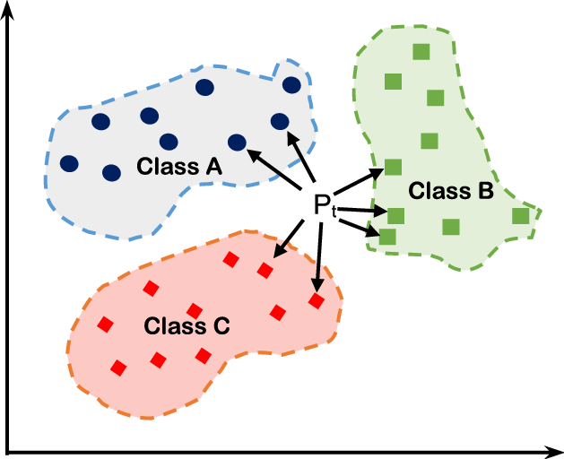
KNN
The core idea behind KNN is to predict the value of a data point based on the average or weighted average of its k nearest neighbors in the feature space.
KNN relies on a distance metric (commonly Euclidean distance) to measure the similarity or proximity between data points in the feature space.
KNN identifies its k nearest neighbors based on the chosen distance metric. These neighbors are the data points with the most similar feature values.
In the case of regression, the predicted value for the target variable is the average (or weighted average) of the target values of its k nearest neighbors.

Slide 9
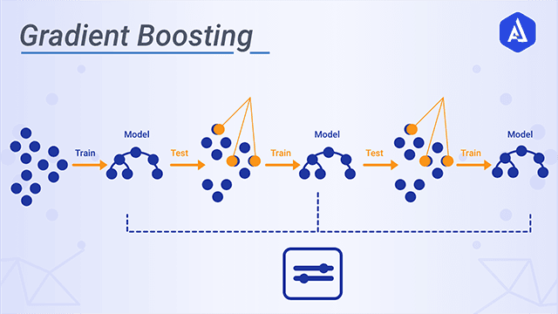
Gradient Boosting
Ensemble learning technique that combines the predictions of multiple weak learners (usually decision trees) to create a robust and accurate predictive model.
It builds trees sequentially, with each new tree correcting the errors of the combined ensemble of trees built so far.
Exhibit non-linear relationships with various factors like location, size, and amenities. Gradient Boosting, with its ability to capture complex relationships, is effective in modeling these non-linearities.
This is crucial in real estate, where factors like location, number of bedrooms, and proximity to amenities can significantly impact property prices.

Slide 10
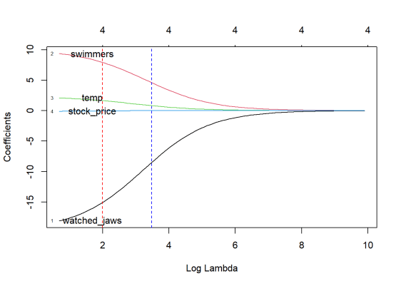
Ridge Regression
Ridge Regression is a linear regression technique designed to address the issue of multicollinearity in the data, where independent variables are highly correlated.
Ridge Regression is particularly useful when dealing with datasets where there is multicollinearity, meaning that independent variables are correlated.
Real estate datasets often involve multiple features that can be correlated, such as the number of bedrooms and the square footage of a property. Ridge Regression is helpful in mitigating the effects of multicollinearity by preventing the regression coefficients from becoming overly sensitive to small changes in the data.

Slide 11
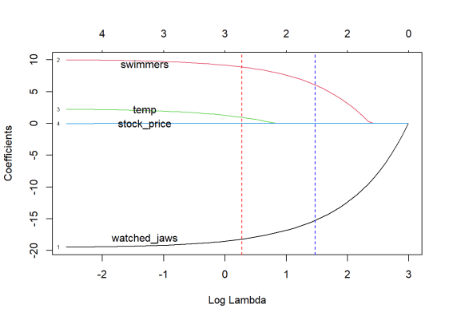
Lasso regression
Lasso Regression, or L1 regularization, is a linear regression technique used for feature selection and regularization
Real estate datasets often include numerous features such as location, size, number of bedrooms, and amenities. Lasso Regression helps identify the most influential features by shrinking less relevant ones to zero.
Lasso looks at all the factors you have (features) and decides which ones are crucial for predicting the house price and which ones can be ignored. It does this by assigning a score to each factor.

Slide 12
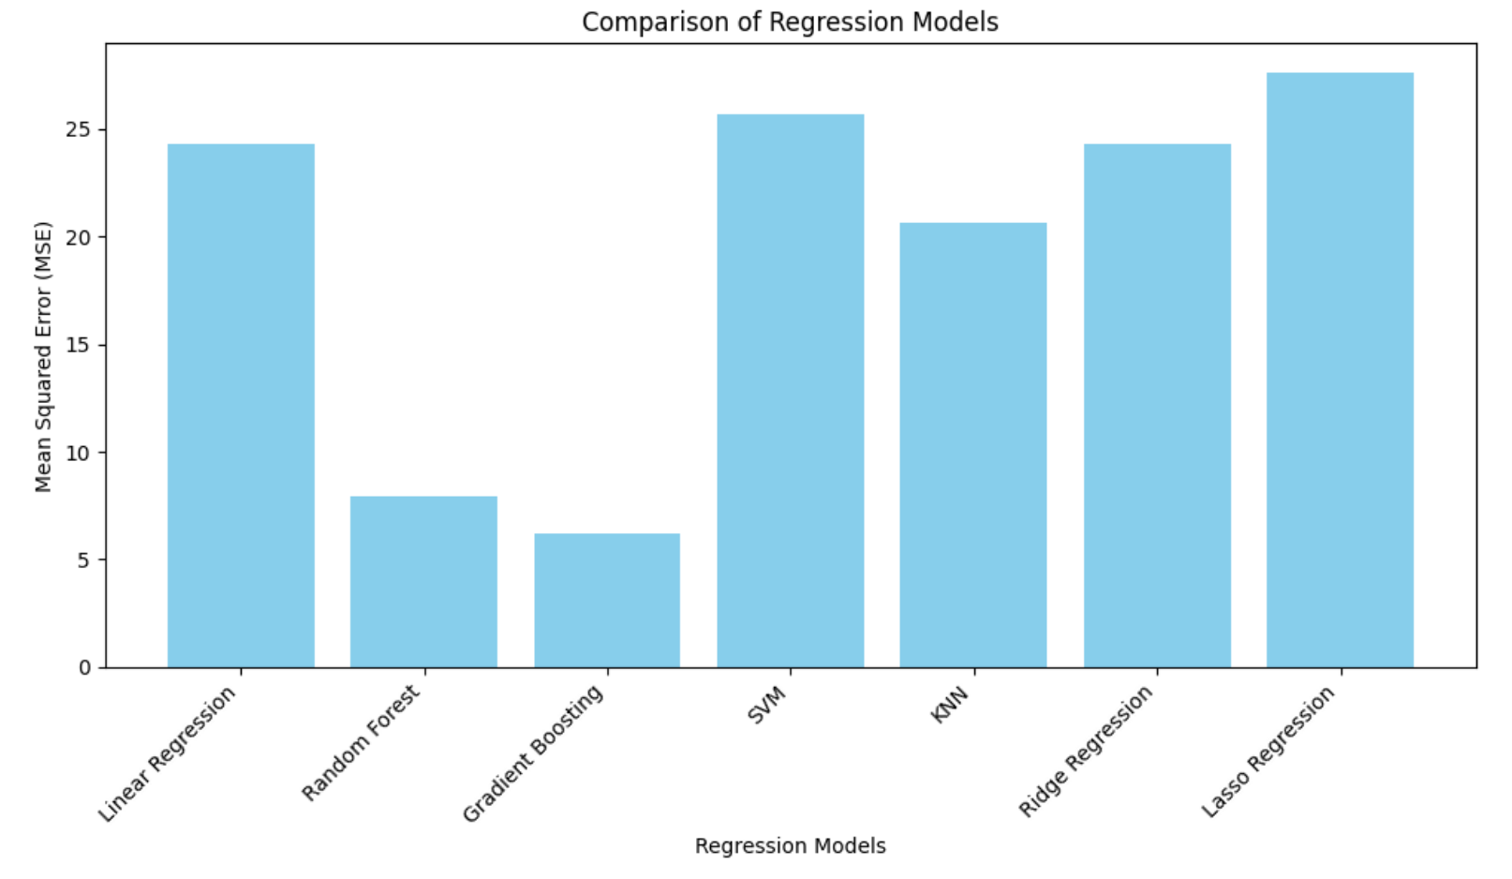
Result

Slide 13
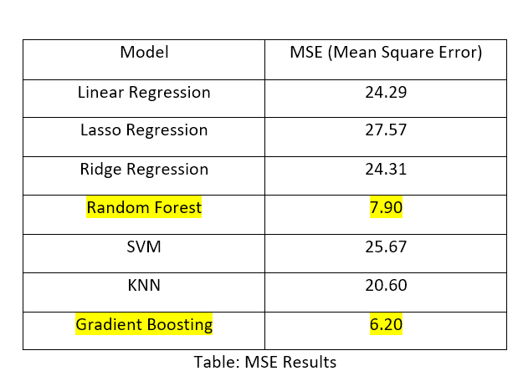
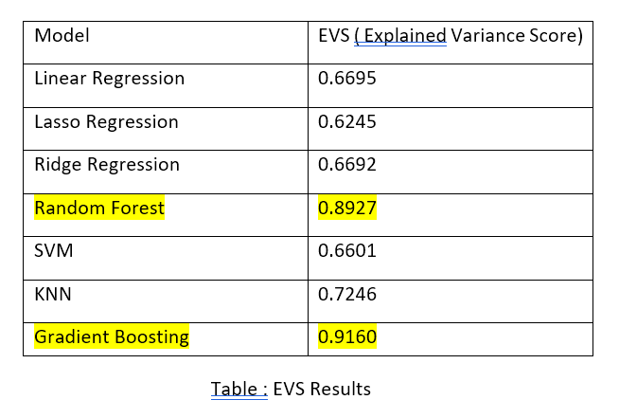
MSE (Mean Squared Error):
Mean Squared Error (MSE) is a common metric used to measure the average squared difference between predicted values and actual values in a dataset.
Explained Variance Score (EVS) is a metric used to assess the proportion of variance in the dependent variable that is explained by the model. It is particularly useful for regression models.

Slide 14
THANK YOU

